Slide 1
@AcornsNetwork
www.acornsnetwork.org.uk
acornsnetwork@soton.ac.uk
www.facebook.com/Acorns.southampton
Project launch: June 27th 2017

Slide 2
Schedule
Welcome
Overview and introductions
What questions or issues matter to you? Why is ACoRNS of interest?
Student voices and experiences
Discussion
Mingling and refreshments

Slide 3
What is ACoRNS?
Improve the lives of children and young people on the autism spectrum
Children with autism
Schools
Families
Community
Researchers

Slide 4
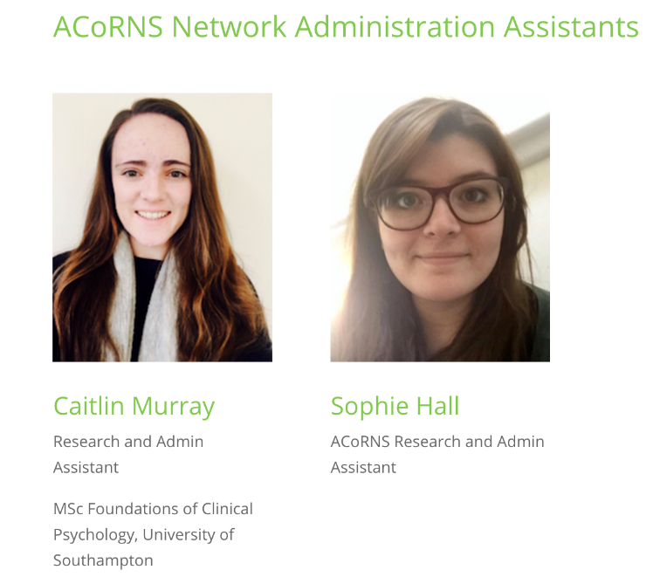
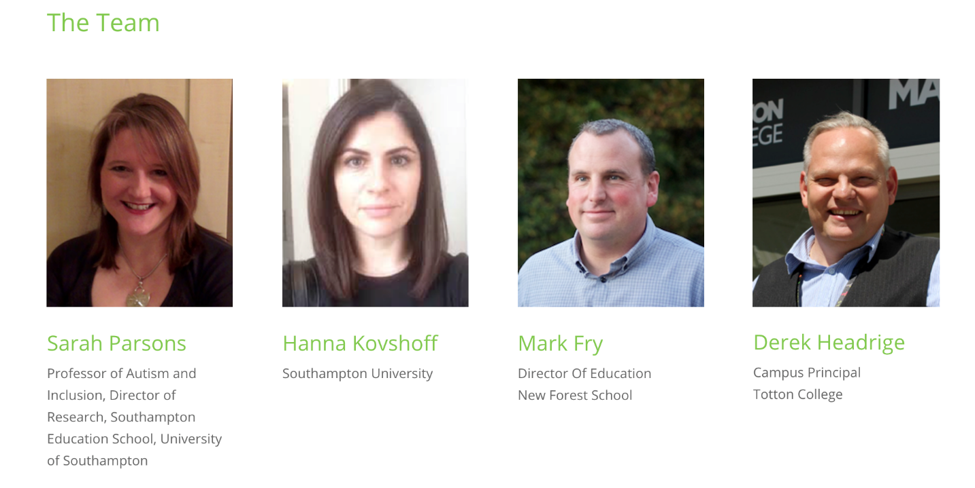
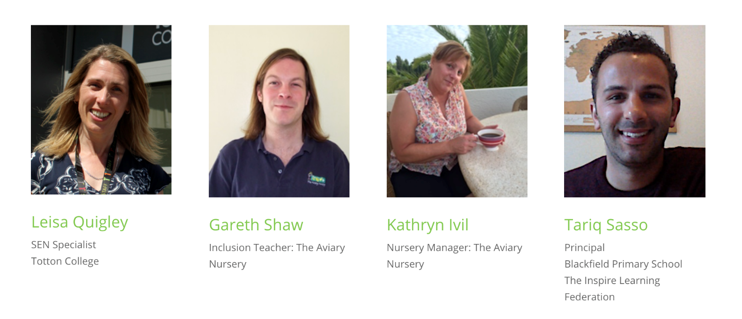
Meet the Team
Richard Cosford – Bitterne Park School

Slide 5
What will we be doing?
Our agreed priorities are educational ‘transitions and trajectories’
Working together to decide what questions can be addressed by research and that matter to practitioners
Researching those questions
Feeding back
Improving and reflecting on practice
Sharing practice and knowledge

Slide 6
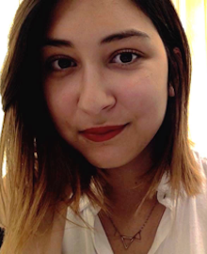
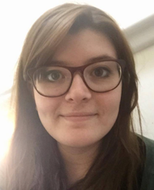
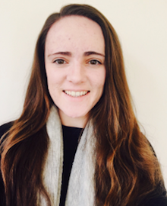
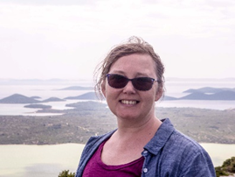
Current projects
MSc Education Management and Leadership
Doctorate in Educational Psychology
BSc Education and Psychology
MSc Foundations of Clinical Psychology
MSc in Clinical and Developmental Neuropsychology

Slide 7
What are the benefits?
Research addresses questions and issues that really matter
Research gets used in practice; practice influences research
Often research is small-scale and difficult to generalise
The more we find out, the more we can influence and apply best practice
We all have knowledge and expertise
We can only be better if we share this!

Slide 8
How can you get involved?
Become an ACoRNS community partner
Get involved in research that matters to you
Influence what we do as a group
Opportunities to share practice
News and updates via website
Share links, events, tips, ideas

Slide 9
Who’s in the room?
Introduce yourselves to the people sat near to you
What are some of the main issues or questions for autism research and practice that matter to you?
Why does ACoRNS interest you?
Please jot questions or comments down!

Slide 10
Over to the students…

